Slide 1
Tech Catalyst Data Engineering
Pavan Gudipudi
Tarek Atwan

Slide 2
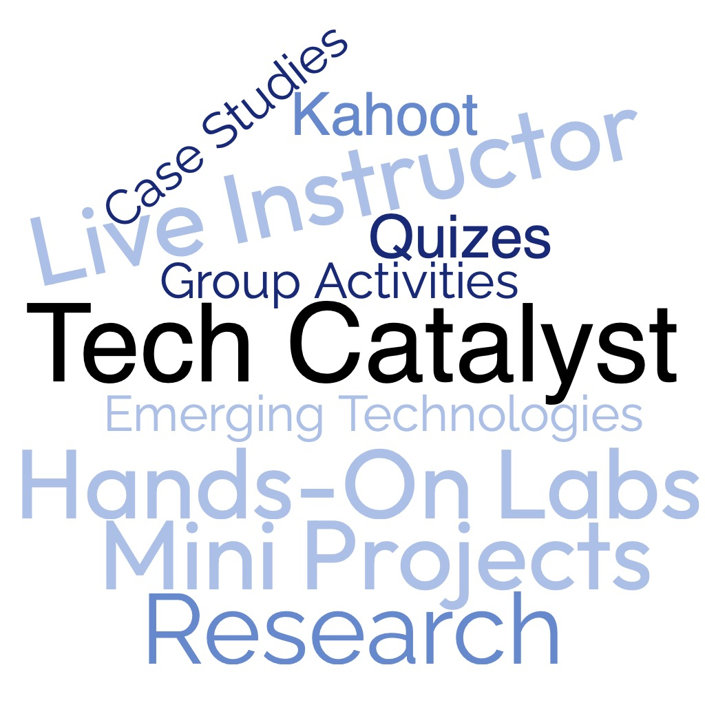
Program Overview
14
Students
8
Weeks
320
Hours
6
Mini Projects
1
Final Capstone

Slide 3
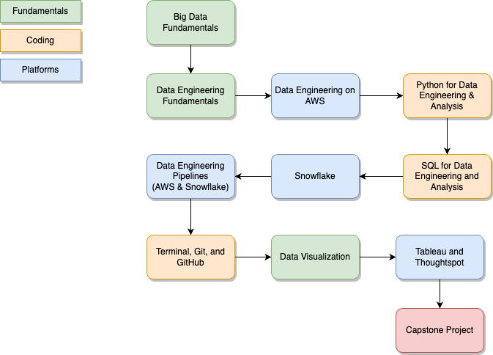
Program Overview
14
Students
8
Weeks
320
Hours
6
Mini Projects
1
Final Capstone

Slide 4
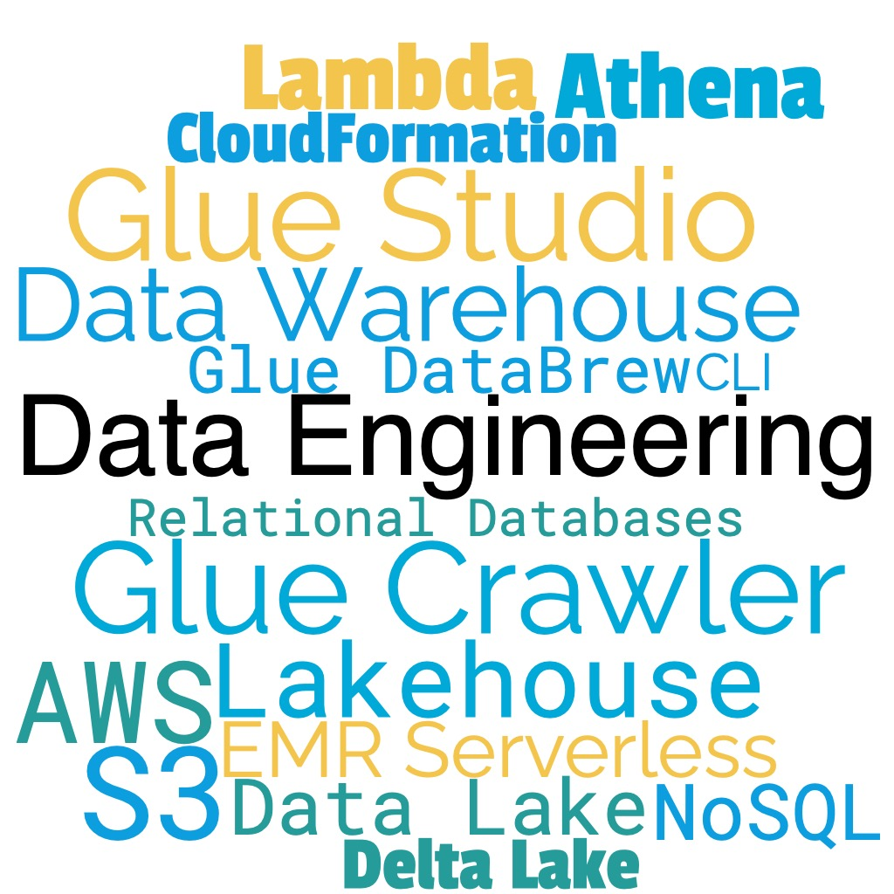
Week 1
Data Engineering on the Cloud: Introduction to Data Engineering Fundamentals including Data Architecture Fundamentals, Data Engineering Primer, and Data Engineering on AWS (Glue Studio, Glue DataBrew, Athena, S3, Glue Crawlers).
Week 1
Week 2
Week 3
Week 4
Week 5
Week 6 Week 7 Week 8

Slide 5
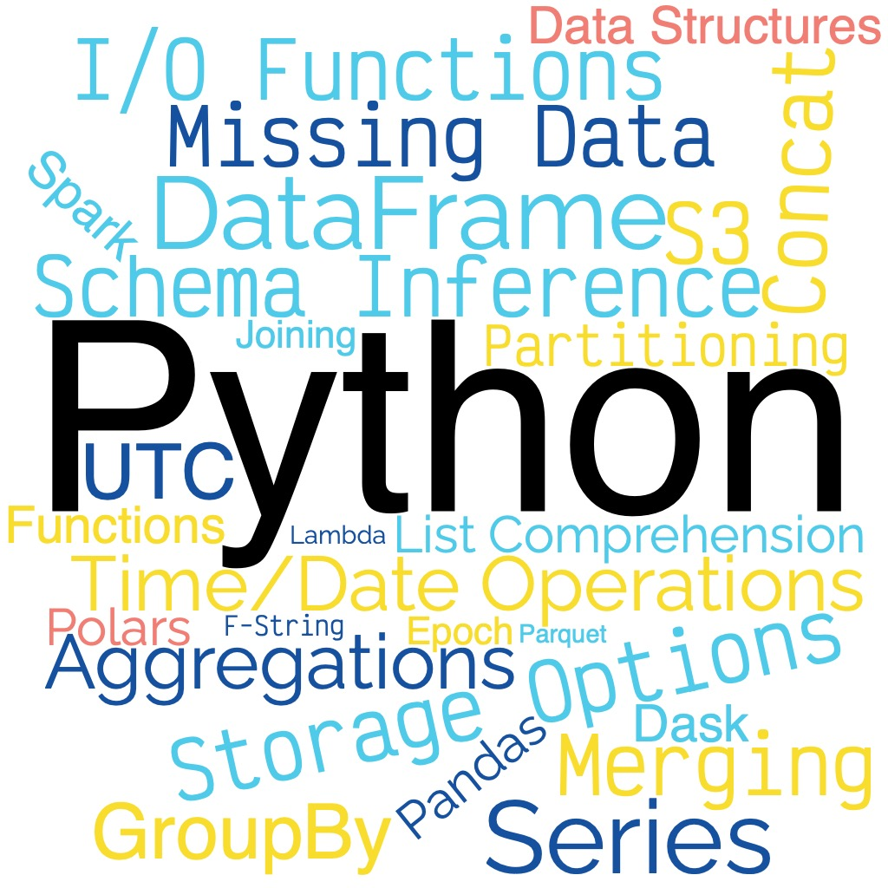
Week 2
Python for Data Engineering & Analytics: Python review, Introduction pandas, work with several I/O capabilities for ingesting, transforming, and loading data using pandas. Read and write to AWS using pandas.
Week 1
Week 2
Week 3
Week 4
Week 5
Week 6 Week 7 Week 8
Case Study

Slide 6
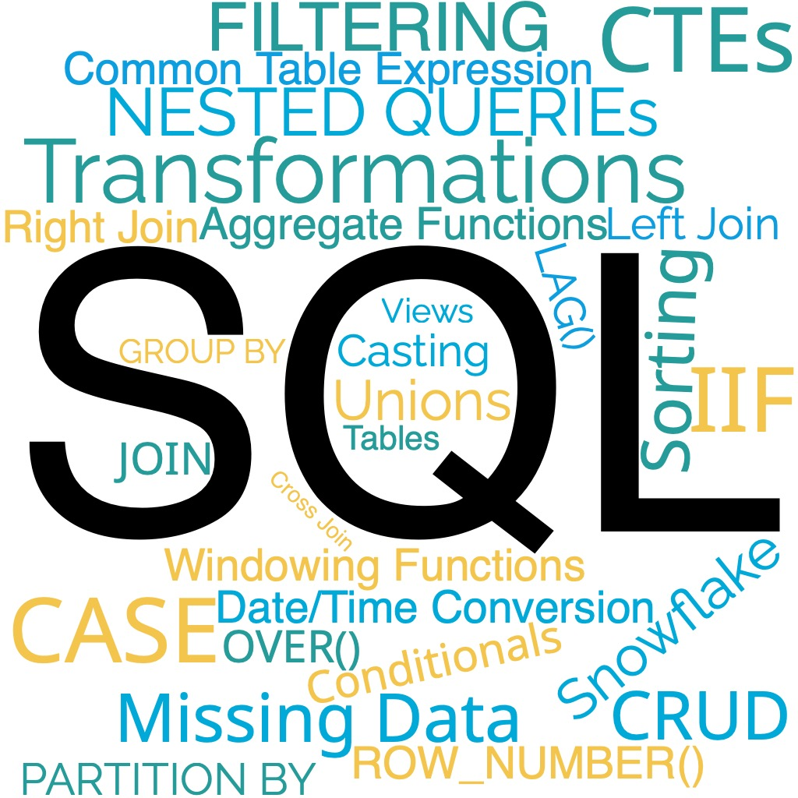
Week 3
SQL for Data Engineering and Analytics: Learn about Relational Database Systems, SQL Foundation Review including: joins, filters, group by, aggregate functions, CTEs, Windowing Functions, and other data manipulation/transformation techniques.
Week 1
Week 2
Week 3
Week 4
Week 5
Week 6 Week 7 Week 8
SQL Project 1

Slide 7
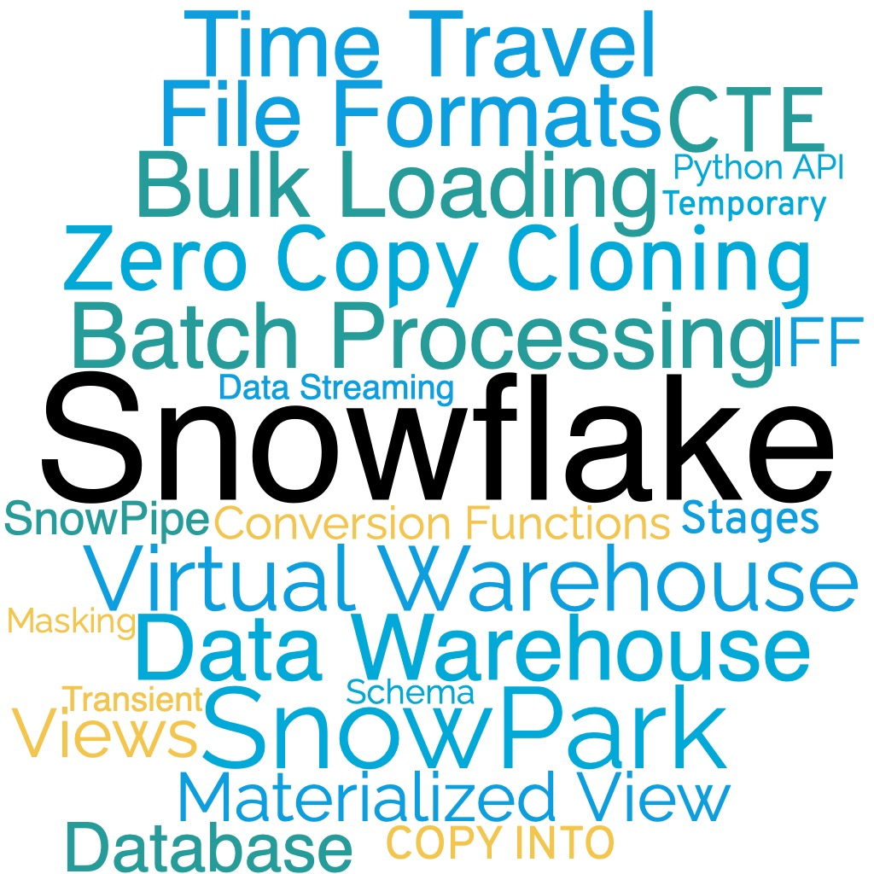
Week 4
Advanced Snowflake: More practice on advanced SQL, Snowflake specifics such as transient, temporary, and permanent tables, materialized and security views, stages, pipes, file formats, COPY INTO, AWS S3 integration, parsing data (CSV, Parquet, JSON).
Week 1
Week 2
Week 3
Week 4
Week 5
Week 6 Week 7 Week 8
SQL Project 2

Slide 8
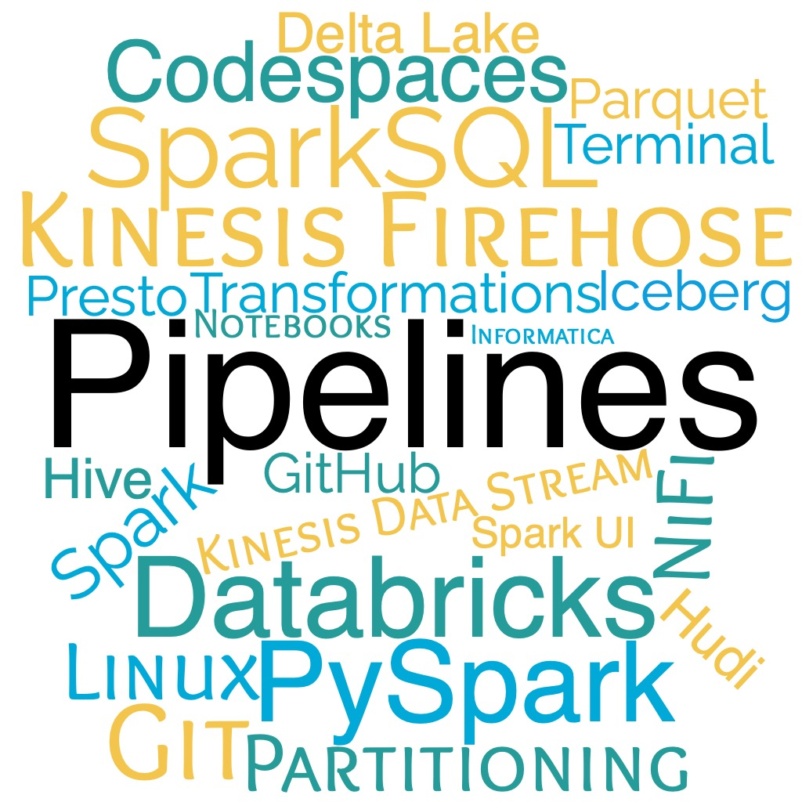
Week 5
Building Data Engineering Pipelines: Hands-on experience building data pipelines on AWS. Learn about Linux and review important terminal commands. Learn about other tools, like Apache NiFi, Informatica, for creating an ETL pipeline.
Week 1
Week 2
Week 3
Week 4
Week 5
Week 6 Week 7 Week 8
Million Song Data Lake and Data Warehouse Project

Slide 9
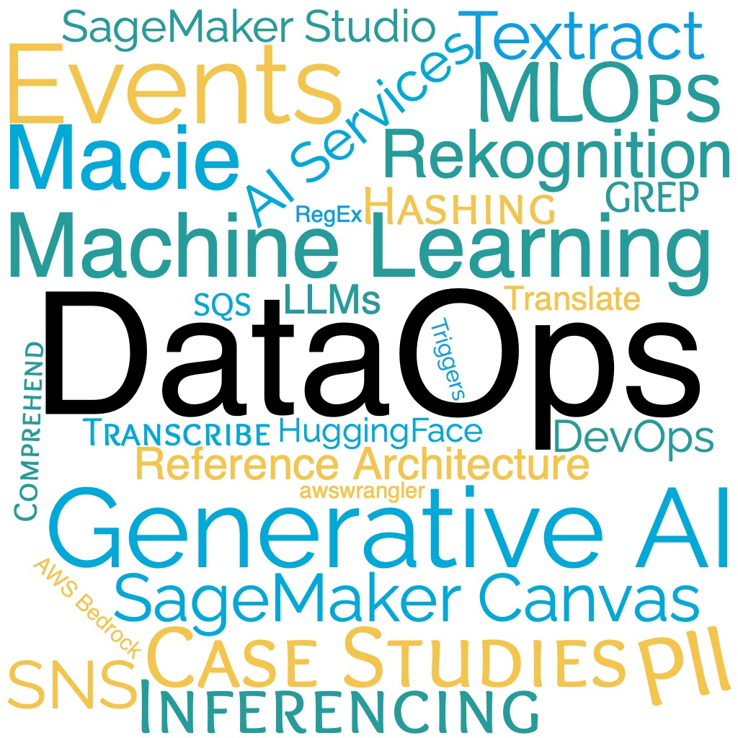
Week 6
DevOps, DataOps, MLOps, and LLMOps: Learn about the role of a Data Engineer in Machine Learning, Artificial Intelligence, and GenAI process and workflow. Dive into DataOps, topics on version control, RegEx, Scheduling, Automation, Orchestration, and Monitoring.
Week 1
Week 2
Week 3
Week 4
Week 5
Week 6 Week 7 Week 8
Case Study: Real-Time Retail Analytics Platform Project

Slide 10
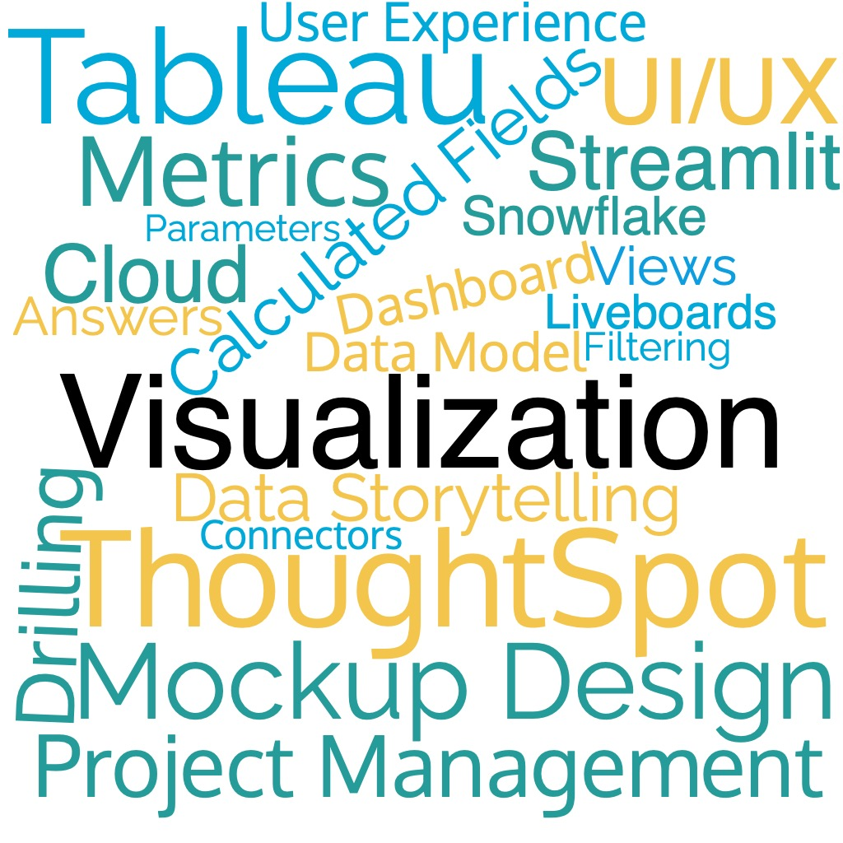
Week 7
Data Visualization Fundamentals: Learn about Data Visualization best practices with hands-on experience using Tableau and Thoughtspot
Week 1
Week 2
Week 3
Week 4
Week 5
Week 6 Week 7 Week 8
Tableau Project

Slide 11
Week 8
Capstone Project : End-to-End project to demonstrate what students have learned
Week 1
Week 2
Week 3
Week 4
Week 5
Week 6 Week 7 Week 8
Final Capstone Project

Slide 12
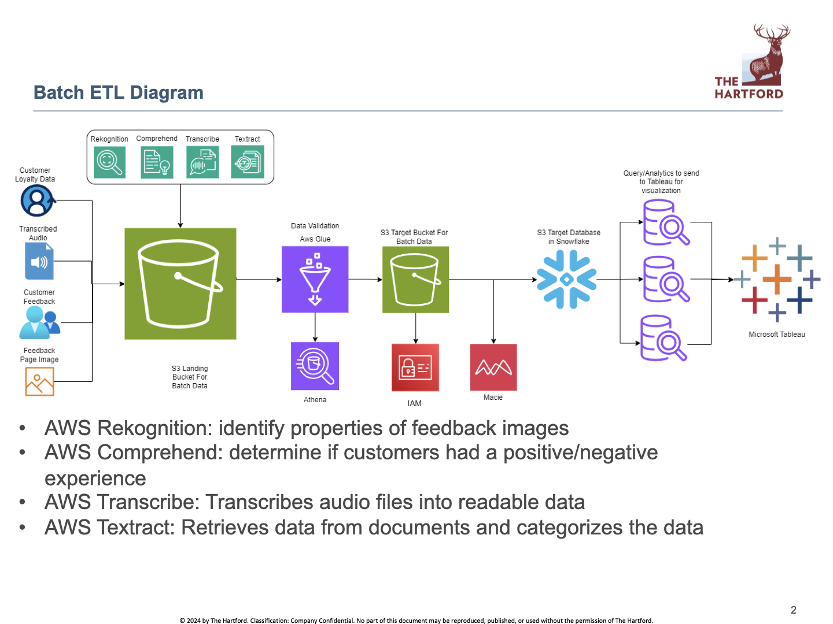
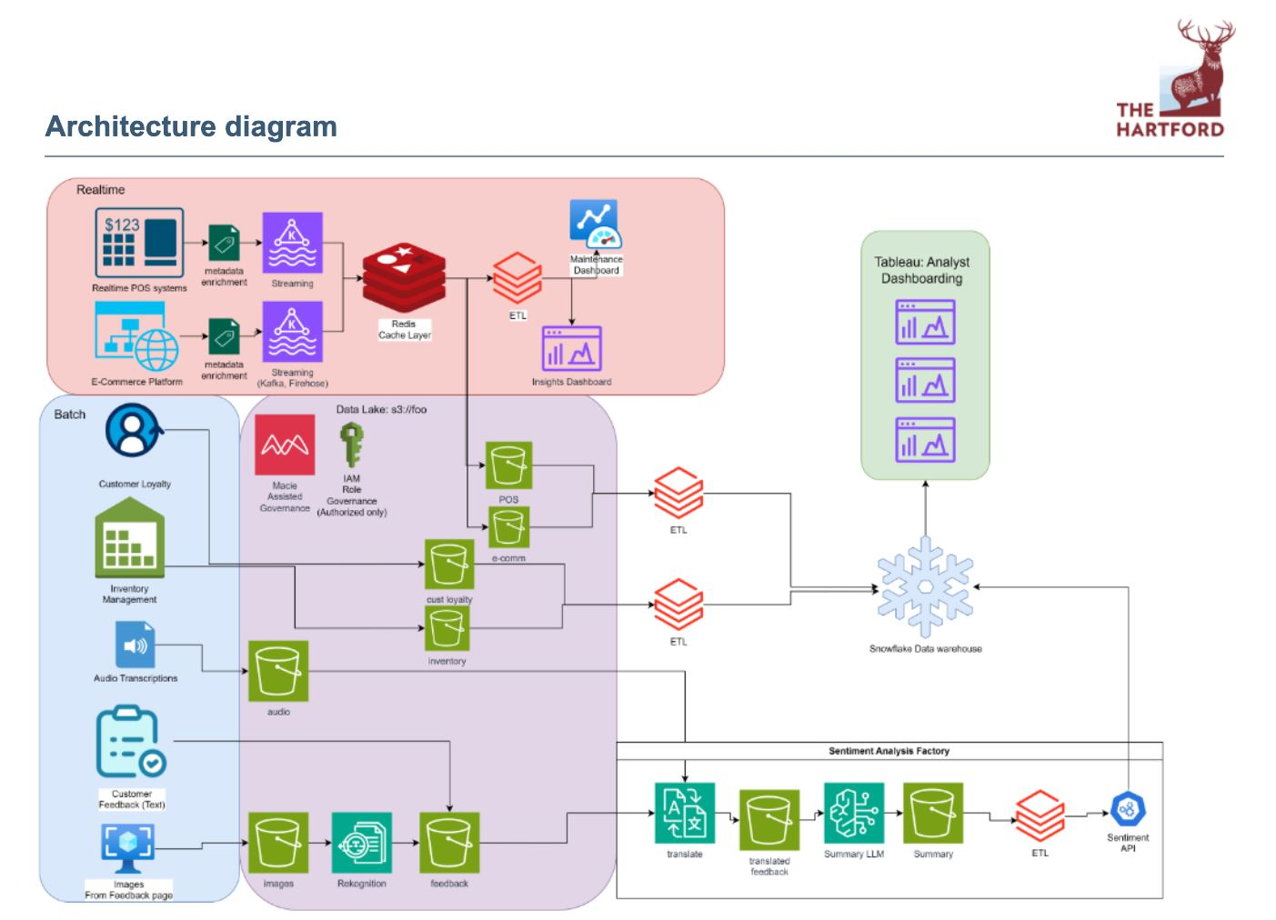
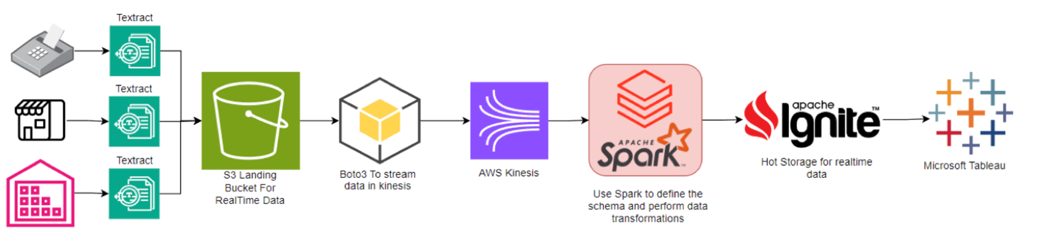
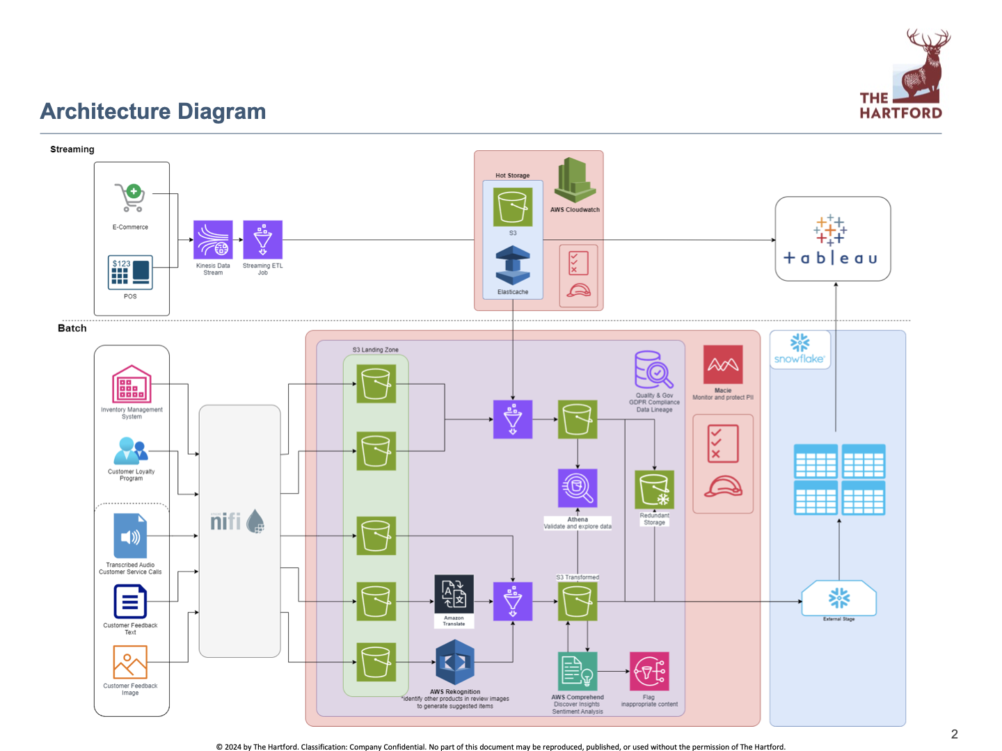
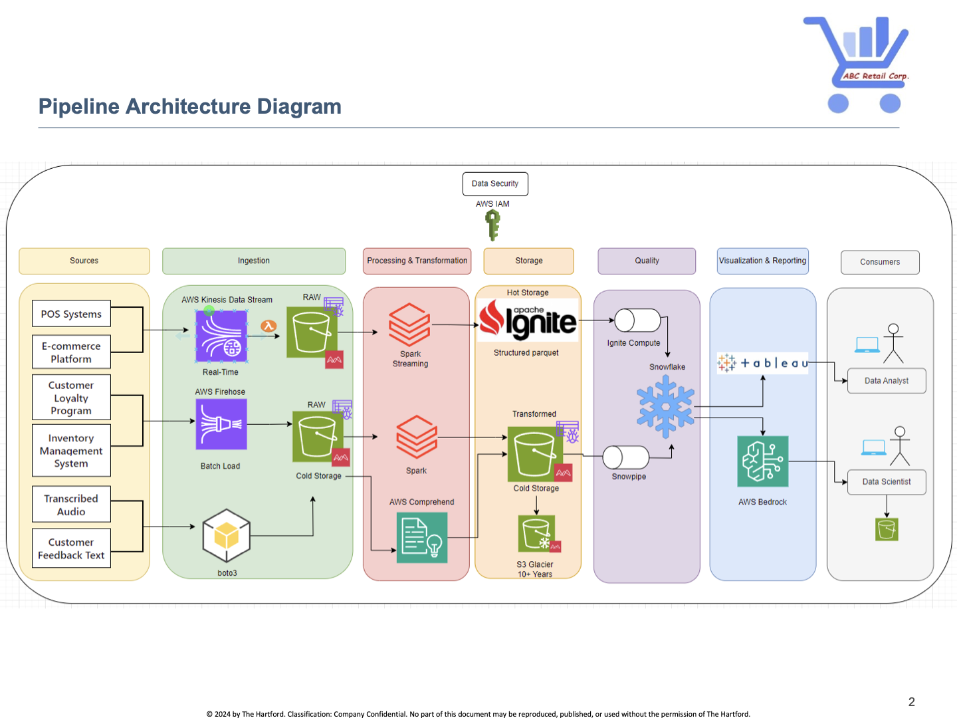
Student Showcase Example

Slide 13
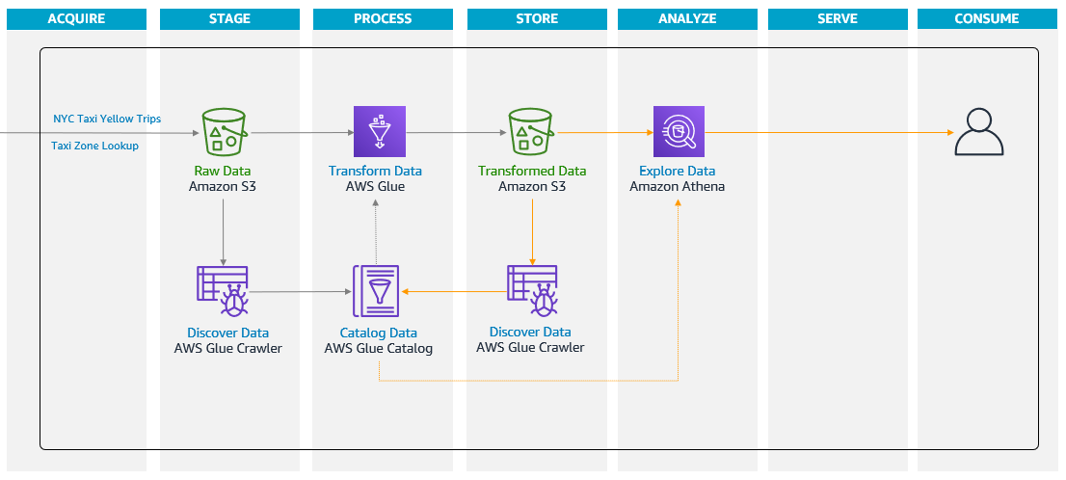
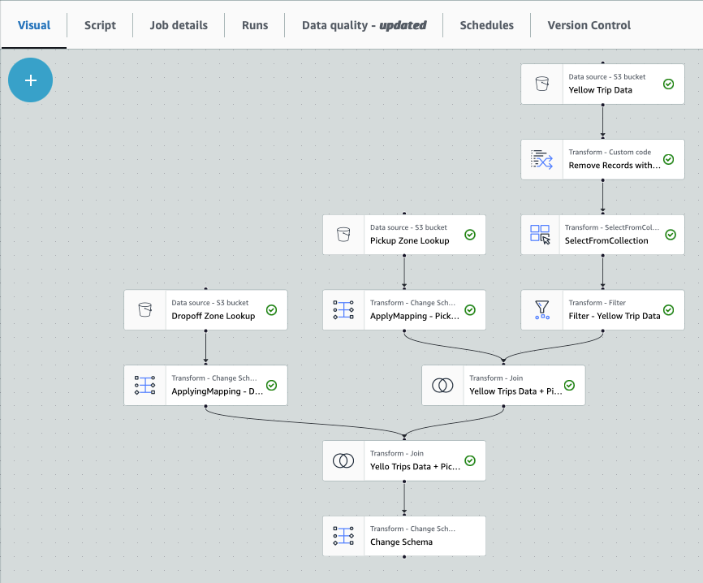
Student Showcase Example

Slide 14
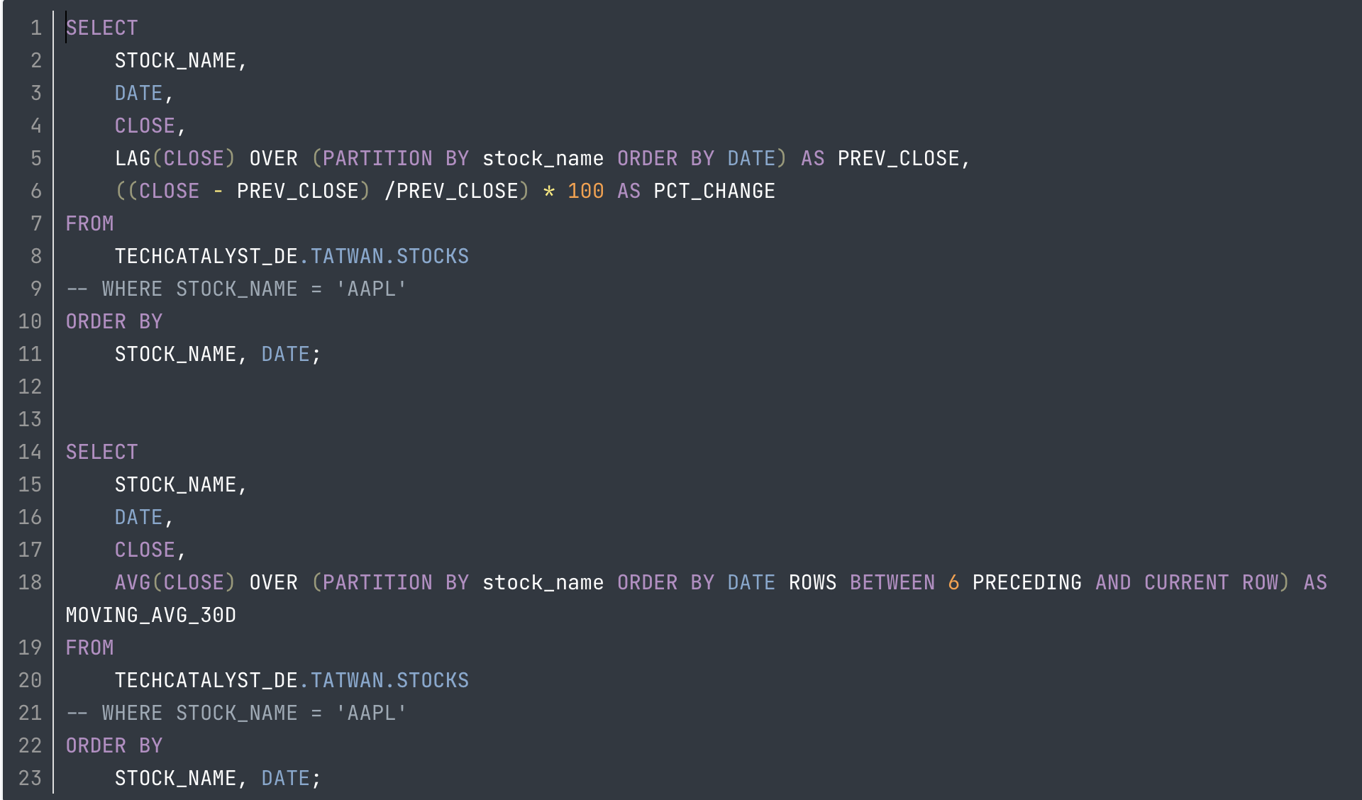
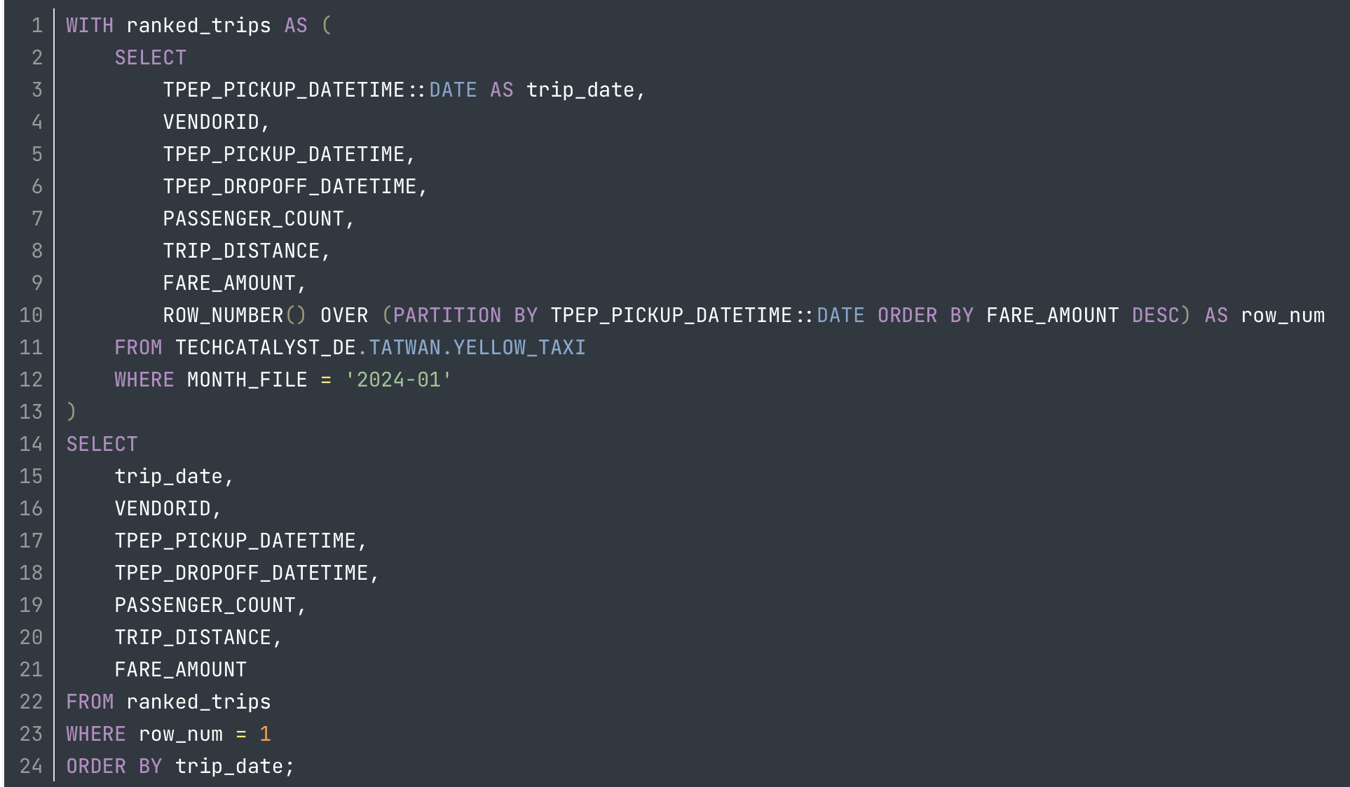
Student Showcase Example

Slide 15
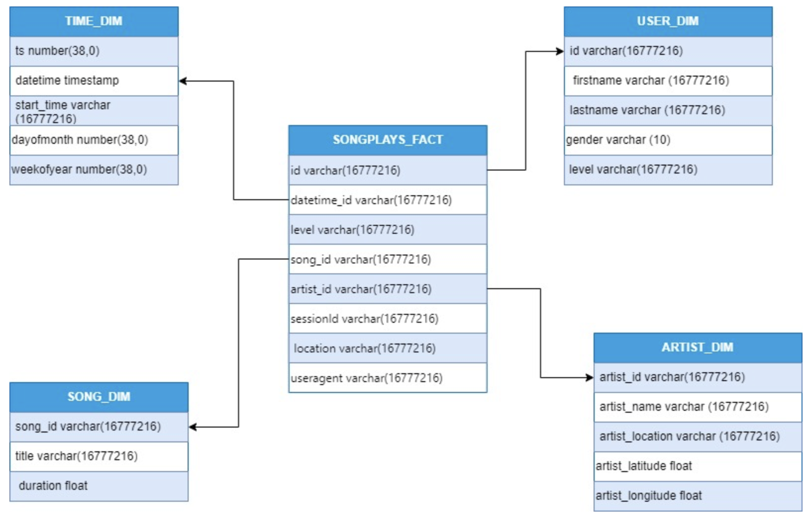
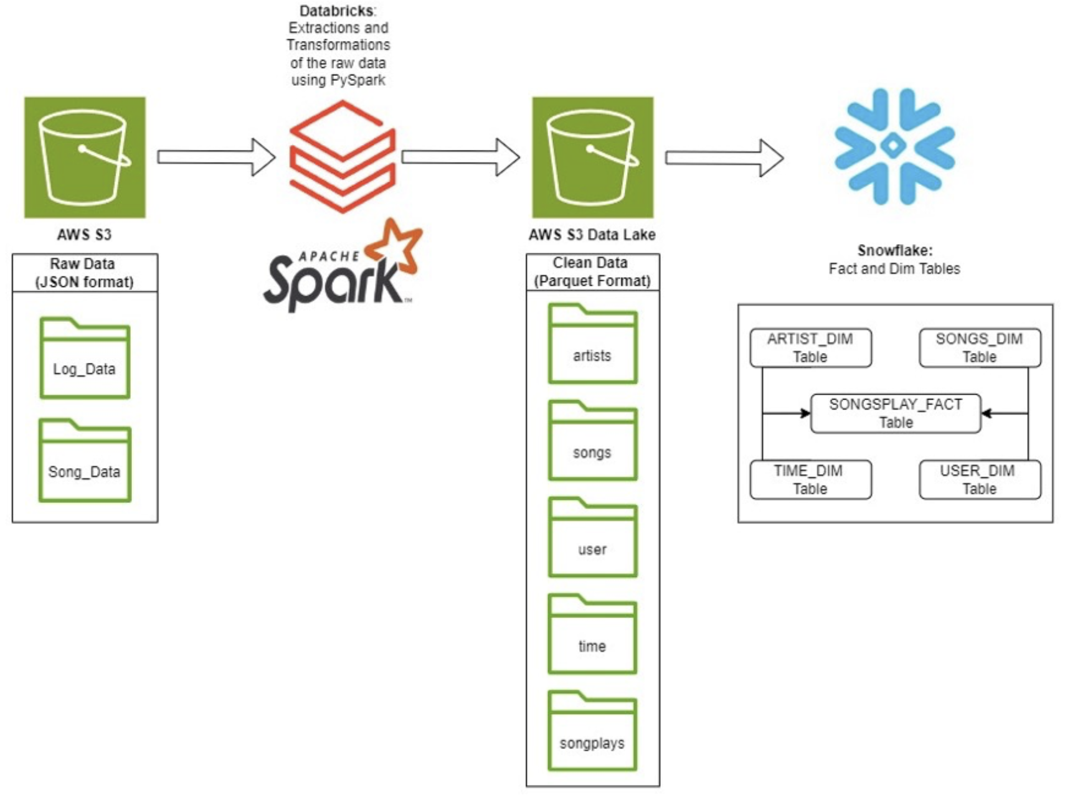
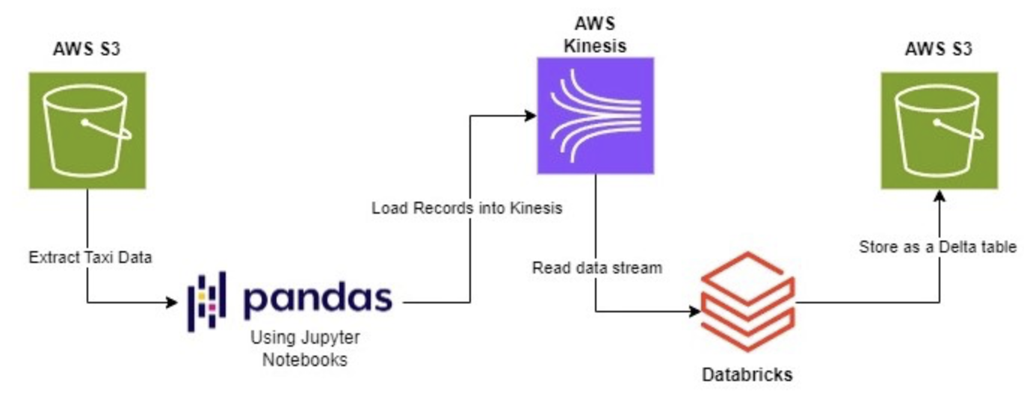
Student Showcase Example – Sparkify Data Lake and DW Project

Slide 16


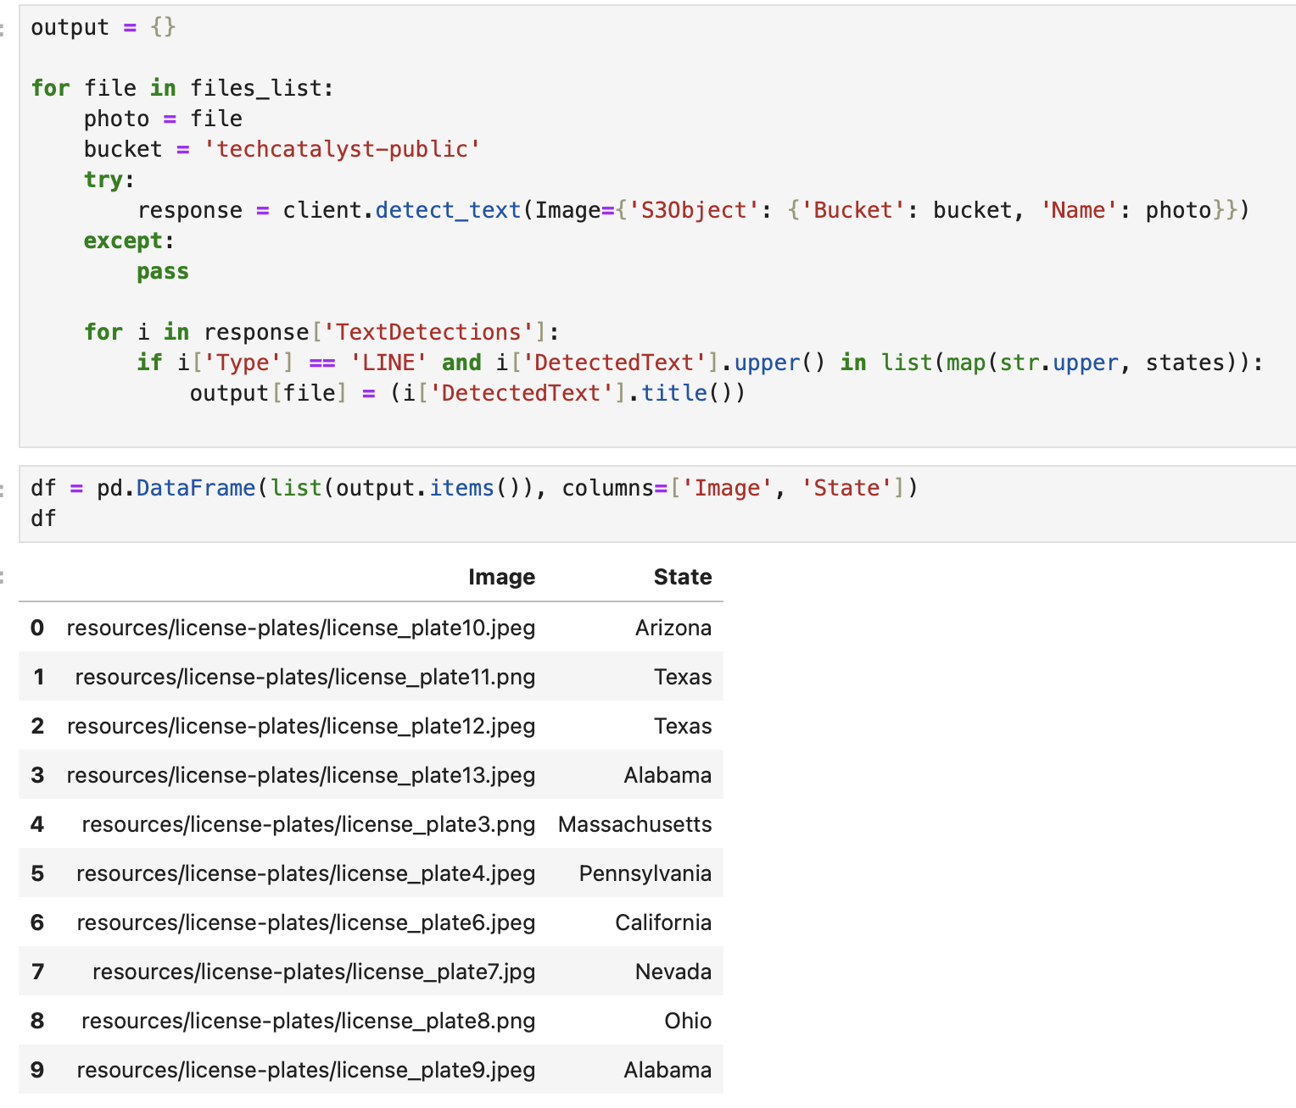
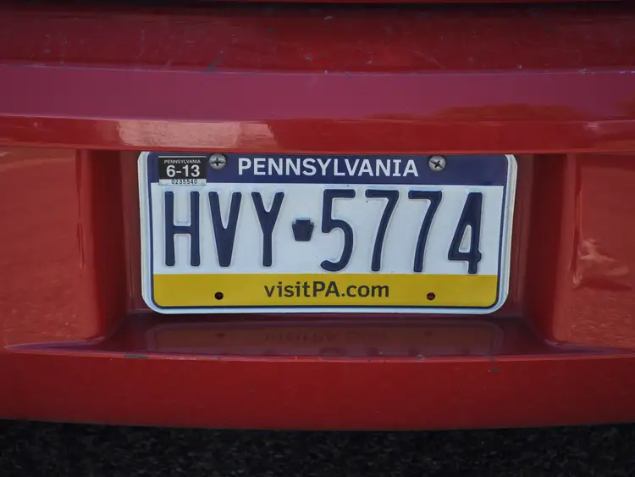
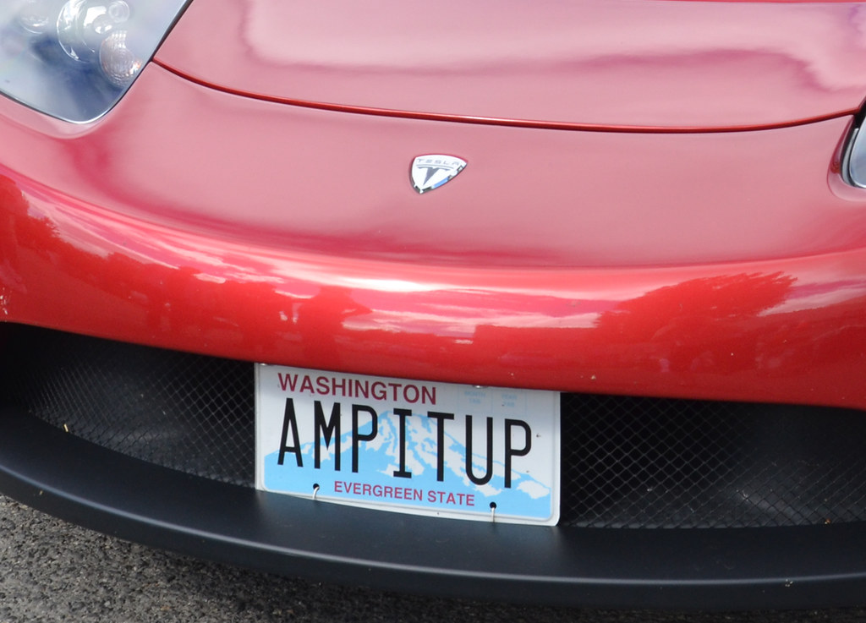
Student Showcase Example – Amazon Rekognition and Comprehend
Amazon Rekognition
Rekognition image

Slide 17
Our Presenters

